Slide 1
Does climate change and vegetation have an effect on mortality of Dall’s sheep?
van de Kerk et al., 2020 - Environmental Influences on Dall's Sheep Survival
Bri S, Tim C, Kyle H, Sam K, Megan C

Slide 2
Response Variable and Predictors Variables
Predictor variables
Season (summer and winter)
Temperature
Normalized difference vegetation index. (NDVI)
Freeze thaw frequency (FTF)
Precipitation
Pacific decadal oscillation (PDO)
Arctic oscillation (AO)
Snow water equivalent (SWE)
Response Variables
Birth mass (lambs)
Age of death (adults)
Survival rate (adults + lambs)
Notes:
Highlighted ones were the most important

Slide 3
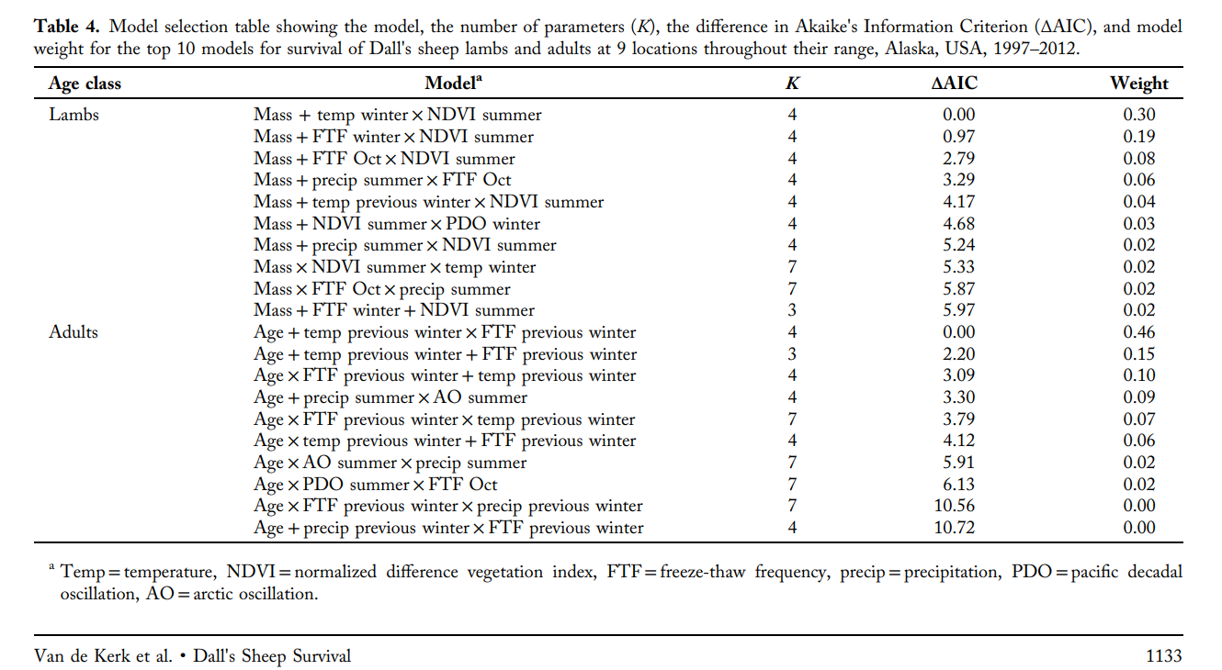
AIC Table
Notes:
This study did prioritize delta AIC since they organized the table in ascending order, ran different models for lambs and for adults

Slide 4
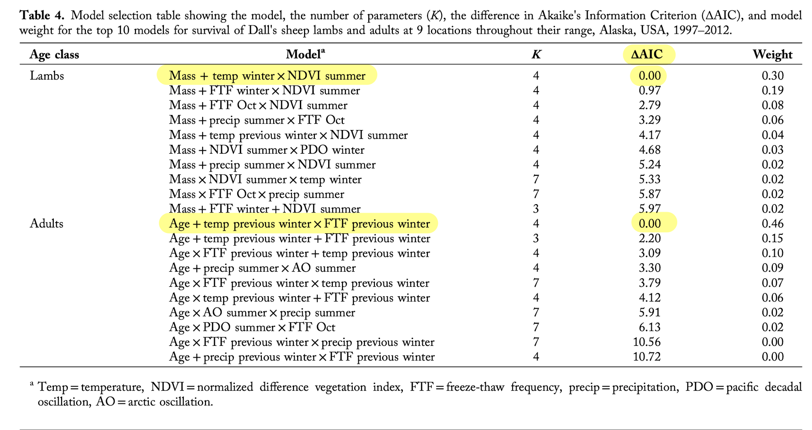
Important models
Notes:
For lambs, mass in addition to the interaction of winter temperature and Normalized Difference Vegetation Index were most influential on survivorship of young
For adults, age in addition to the interaction of temperatures of previous winters and freeze-thaw-frequency

Slide 5
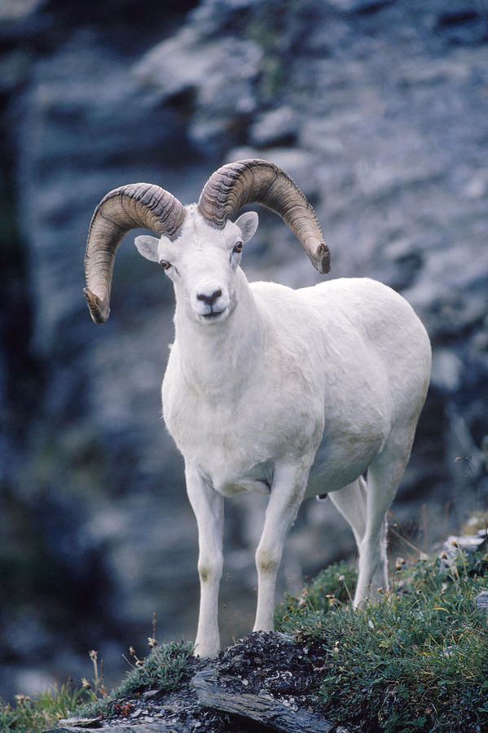
Concluding remarks
Different models worked best for lambs versus adults
This demonstrates different variables affecting survivorship of sheep at different points in their life history

